Slide 1
Lecture 9
Stochastic processes: Introduction to Poisson processes
Statistical computing: The independent Metropolis-Hastings sampler
R-packages for MCMC sampling

Slide 2
Independent Metropolis-Hastings
m <- 5000 #length of chain
xt <- numeric(m)
#initial values, etc
a <- 1 #parameter of Beta(a,b) proposal dist.
b <- 1 #parameter of Beta(a,b) proposal dist.
p <- .2 #mixing parameter
n <- 30 #sample size
mu <- c(0, 5) #parameters of the normal densities
sigma <- c(1, 1)
# generate the observed sample
i <- sample(1:2, size=n, replace=TRUE, prob=c(p, 1-p))
x <- rnorm(n, mu[i], sigma[i])

Slide 3
# generate the independence sampler chain
u <- runif(m)
y <- rbeta(m, a, b) #this is the proposal distribution
xt[1] <- .5
for (i in 2:m) {
fy <- y[i] * dnorm(x, mu[1], sigma[1]) +
(1-y[i]) * dnorm(x, mu[2], sigma[2])
fx <- xt[i-1] * dnorm(x, mu[1], sigma[1]) +
(1-xt[i-1]) * dnorm(x, mu[2], sigma[2])
r <- prod(fy / fx) *
(xt[i-1]^(a-1) * (1-xt[i-1])^(b-1)) /
(y[i]^(a-1) * (1-y[i])^(b-1))
if (u[i] <= r) xt[i] <- y[i] else
xt[i] <- xt[i-1]
}
mean(xt[101:m]) [1] 0.1226097

Slide 4
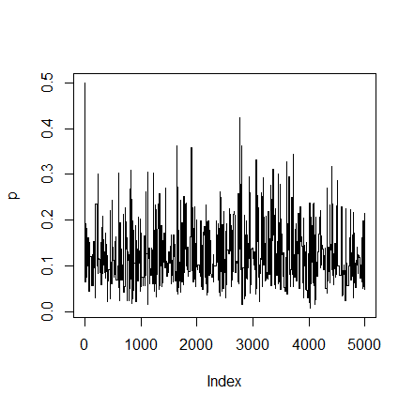
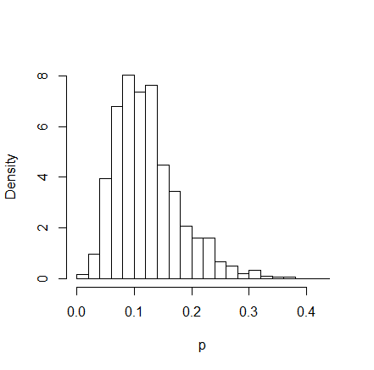
plot(xt, type="l", ylab="p")
hist(xt[101:m], main="", xlab="p", breaks=25,prob=TRUE)

Slide 5
Normal-Normal example
y<-rnorm(10000,3,2)
sig<-2
mean(y)
[1] 2.989198
> sd(y)
[1] 2.000574
n<-30

Slide 6
#prior parameters
mu0<-2
tau0<-0.5
#weight
w<-tau0^2/(tau0^2+(sig^2/n))
#posterior mean
mup<-w*mean(y)+(1-w)*mu0
#posterior sd
sigp<-sqrt(1/((1/tau0^2)+(n/sig^2)))

Slide 7
#for a direct simulation of the posterior normal use:
bayes1<-rnorm(10000,mup,sigp)
quantile(bayes1)
0% 25% 50% 75% 100%
1.408262 2.469917 2.661386 2.856029 3.785107

Slide 8
##Now use MCMCpack
bayes2<-MCnormalnormal(y,sig^2,mu0,tau0^2,10000)
Iterations = 1:10000
Thinning interval = 1
Number of chains = 1
Sample size per chain = 10000
1. Empirical mean and standard deviation for each variable,
plus standard error of the mean:
Mean SD Naive SE Time-series SE
3.0157293 0.0200459 0.0002005 0.0001963
2. Quantiles for each variable:
2.5% 25% 50% 75% 97.5%
2.977 3.002 3.016 3.029 3.055

Slide 9
#Now plot together the prior, likelihood and posterior densities
x<-seq(0,6,0.01)
plot(x,dnorm(x,mu0,tau0),type="l",lwd=1.8,ylim=c(0,1.5),xlab='mu',ylab='density',col=2)
lines(x,dnorm(x,mean(y),sig/sqrt(n)),lty=8,lwd=1.8,col=3)
lines(density(bayes1),lty=4,col=4)
legend(locator(1),c("prior","likelihood","posterior"),col=2:4,lty=c(1,8,4))

Slide 10
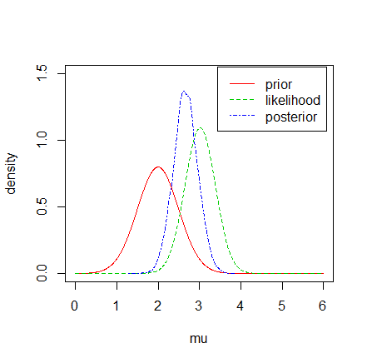

Slide 11
Readings
https://deepblue.lib.umich.edu/bitstream/handle/2027.42/116223/rnews06.pdf?sequence=1&isAllowed=y
https://www.r-bloggers.com/tag/mcmcpack-package/

